Slide 1

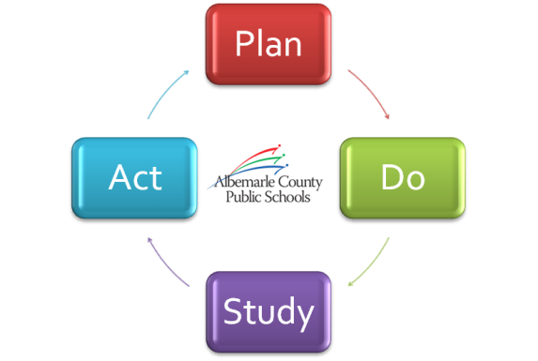
Preparing Our Students for Success
Taking a close look at strategy
June 14, 2012

Slide 2
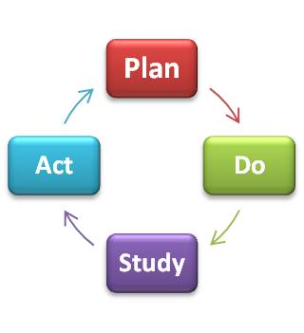

Maintaining Our Strategic Alignment
Vision
Mission
Goals
√
√
√
School Board (Formation)
June
Division Priorities
Superintendent
Division Strategies
Division Leaders
(Implementation)
Division KPIs
July/August
Division Improvement Plans
School/Department Improvement Plans

Slide 3
School Board Annual Retreat
Review Progress
Recommit to:
  Vision
  Mission
  Goals
  Priorities
Evaluate KPIs
New!

Slide 4

Recap of June 4th Retreat
KPI Evaluation
KPI Valuation
  Red = Consensus
  Blue = 4 or More
  White = 1 Individual
Goal and Priority Discussion

Slide 5
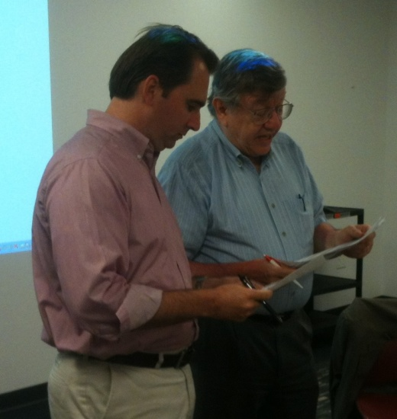
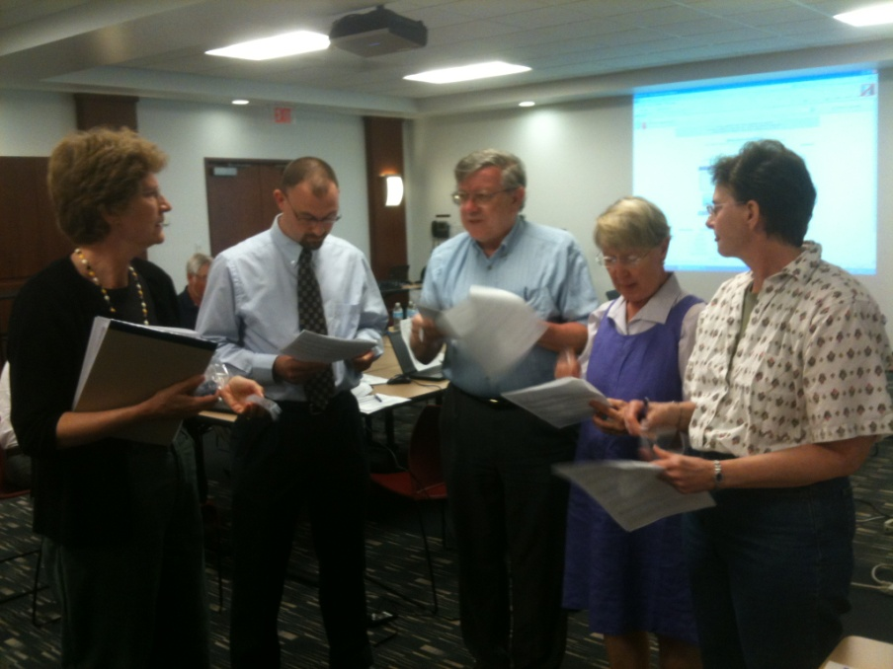
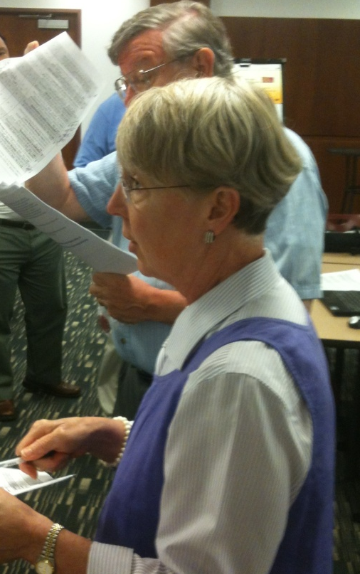
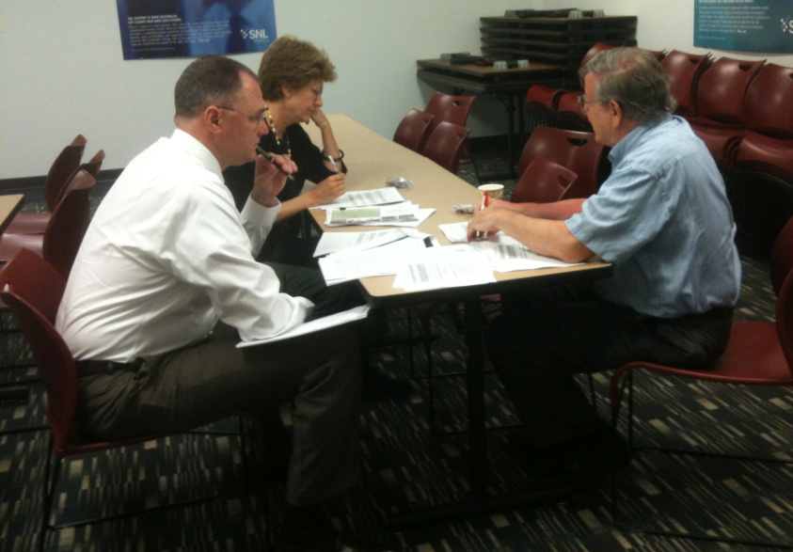
Recap of June 4th Retreat

Slide 6
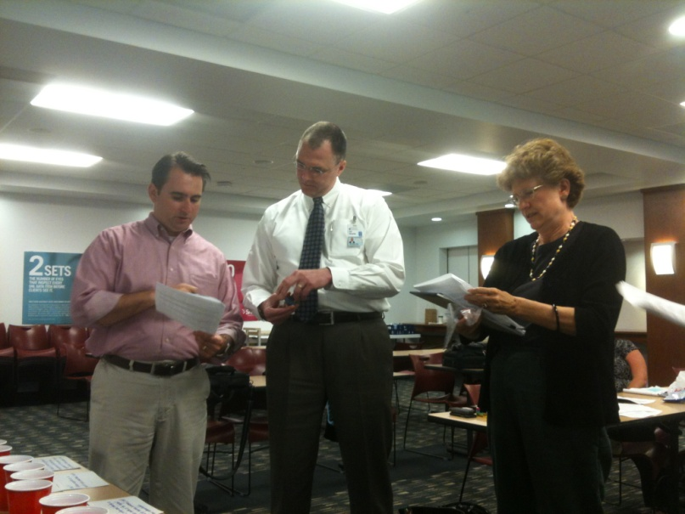
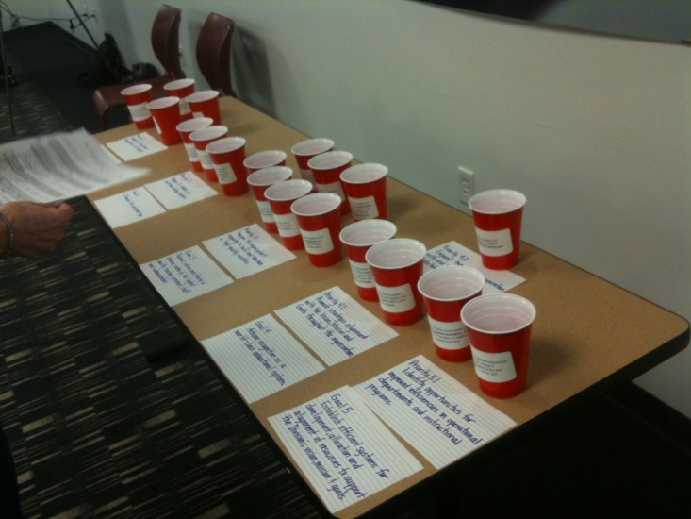
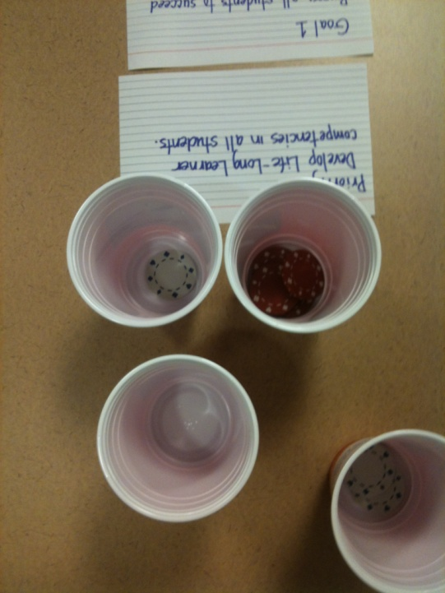
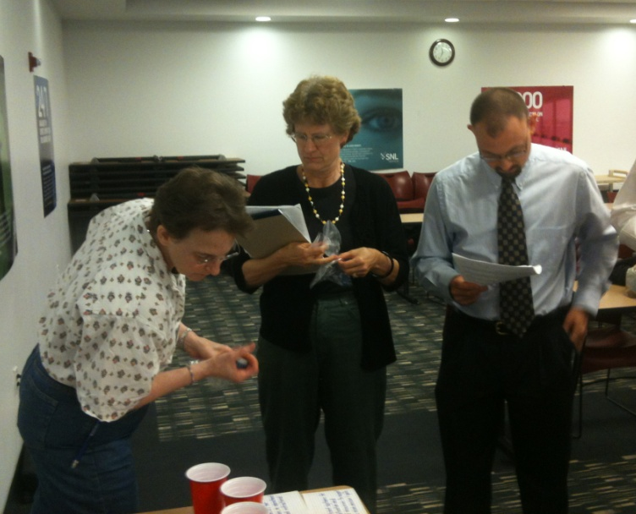
Recap of June 4th Retreat

Slide 7

Board KPI Discussion – Our Focus
Red
3
Student Feedback - Lifelong Learning
Performance Tasks
Blue
5
Learning Spaces
Workforce Engagement
Program Evaluation & Valuation
Workforce Understanding - Vision, Mission, Goals
Strategic Communications
Baldrige Criteria for “World-Class”
Keep 8 KPIs

Slide 8

Combine KPIs
2 Performance Task KPIs into 1
  KPI 2.11a & 2.12a
2 Program Evaluation KPIs into 1
  KPI 5.11a & 5.11b
  KPI Change = 2

Slide 9

Move from Strategic to Operational
Periodic Updates
Learning Walks
  KPIs 1.11c, 1.11d
Strategic Partnerships
  KPI 2.13a
Recruitment, Hiring, Retention, PD Needs
  KPIs 3.11a, 3.11b, 3.11c, 3.11e, 3.12b
TPA Update
  KPI 3.12a
  KPI Change = 9

Slide 10

A Recommended Addition
Academic Excellence Measure
  Scorecard to measure “World Class” for Goal 4
  Include national comparisons & local indicators
  KPI Change = 1

Slide 11
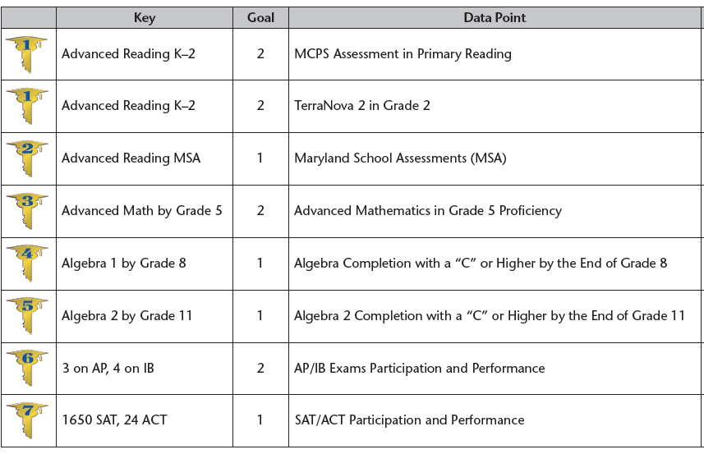
Montgomery County Example
Seven Keys to College & Career Readiness
Notes:
http://www.montgomeryschoolsmd.org/info/keys/documents/sevenkeys.pdf
http://www.montgomeryschoolsmd.org/about/strategicplan/annualreport/pdf/2011AnnualReport.pdf

Slide 12
Recap of KPI Recommendations
# of KPIs Under Review | 19
Combine | 2
Move to Operational | 9
Add | 1
Total KPIs Remaining | 9

Slide 13
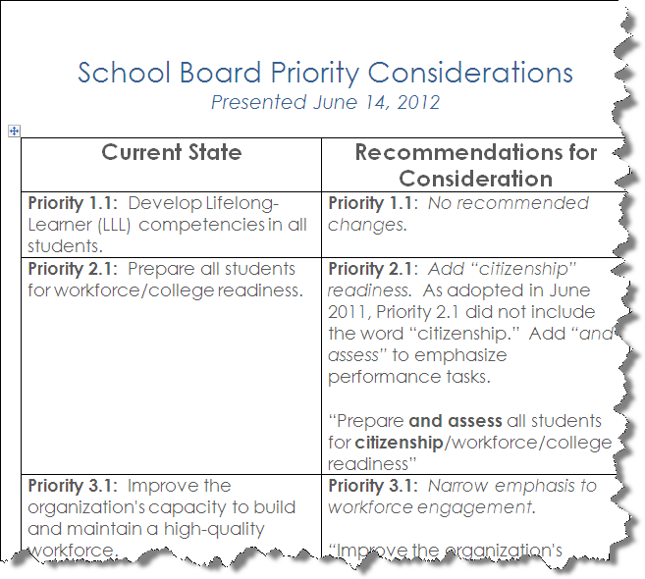
Board Priority Considerations
Notes:
Link to Word document with full table of recommendations.

Slide 14

Next Steps:
June 28th - Board Work Session
  Staff present proposal for Strategic Plan review process
  Board direction on changes to Priorities
July 12th – Board Meeting
  Board direction on Strategic Plan review process
  Q4/EOY Strategic Update
Summer – Alignment
  Leadership Team notified of Board decisions
  Leaders align School & Department Improvement Plans
Summer/Fall – Implementation
  Comprehensive stakeholder review/revision of Strategic Plan

